Slide 1

Custom model and Preprocessing with Tensorflow
Hands-On Machine Learning Part2
& Deep Learning from Scratch 3
TAVE Research DL001
Heeji Won

Slide 2
Contents
01. Custom model and training
02. Data loading and Preprocessing
03. Deep learning from Scratch

Slide 3
Contents
01. Custom model and training
02. Data loading and Preprocessing
03. Deep learning from Scratch

Slide 4
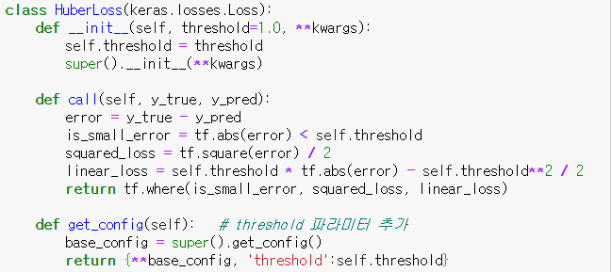
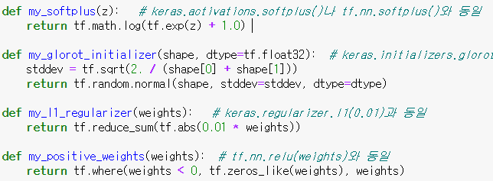

01. Custom model and training
Loss function
Activation function, initializer, regularizer, constraints

Slide 5
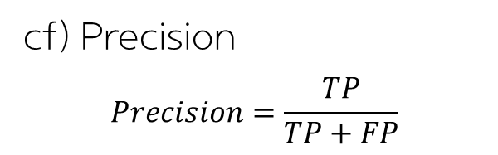
01. Custom model and training
Metrics vs Loss
cf) Precision
$$Precision=\frac{TP}{TP+FP}$$
Metrics is not different from loss essentially
Loss is for training (differentiable)
Metrics is for evaluating (easy)
In practice, making metrics function is the same as making loss function
> Streaming metric (or stateful metric)
updates gradually with each batch
Actual
Actual
 | P | N
P | 4(TP) | 1(FP)
N
 | P | N
P | 0(TP) | 3(FP)
N
Predicted
Predicted
80%
0%
40%?
50%
Streaming metric is necessary

Slide 6
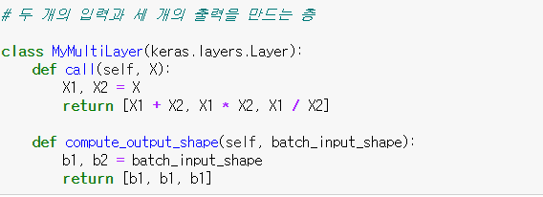
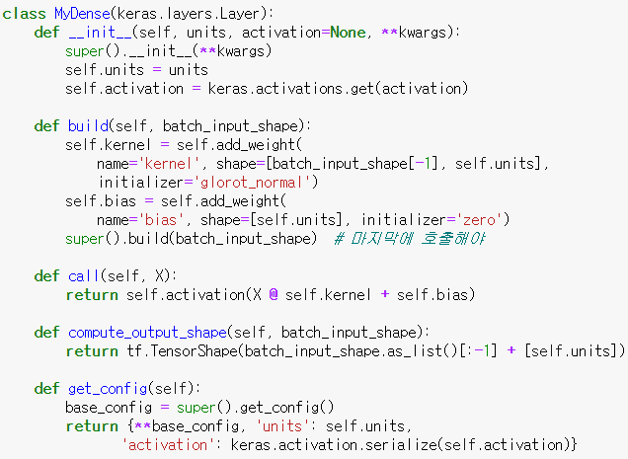
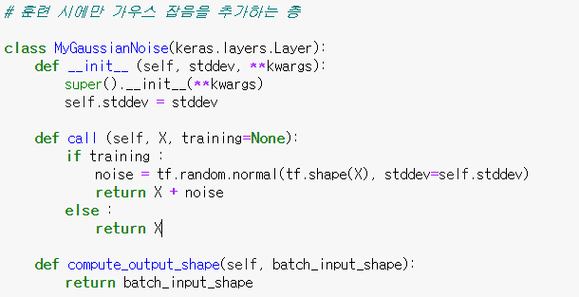

01. Custom model and training
Custom layers
Simple Dense layer
Multiple inputs
- Behaving differently in train set and test set

Slide 7
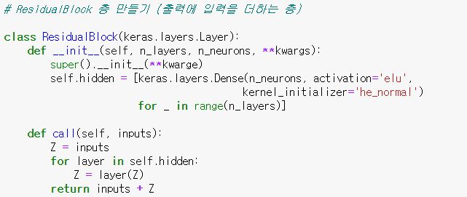
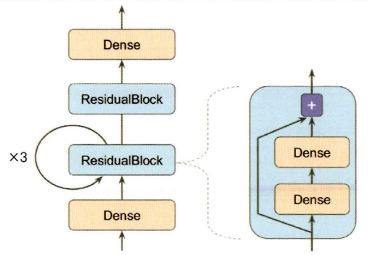
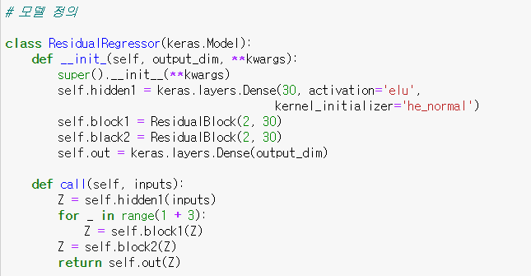
01. Custom model and training
Custom model
- Model with ResidualBlock layer

Slide 8
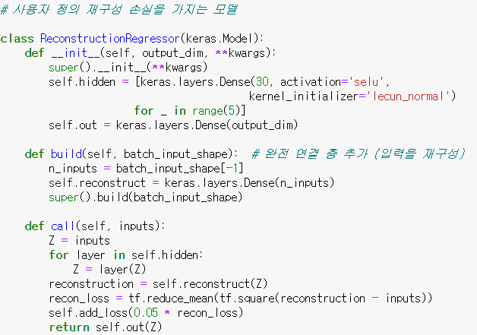
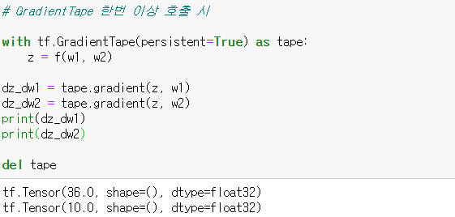
01. Custom model and training
Reconstruction loss
: MSE between Reconstruction and input
Automatic differentiation

Slide 9
01. Custom model and training
Reconstruction loss
: MSE between Reconstruction and input
Automatic differentiation

Slide 10
Contents
01. Custom model and training
02. Data loading and Preprocessing
03. Deep learning from Scratch

Slide 11
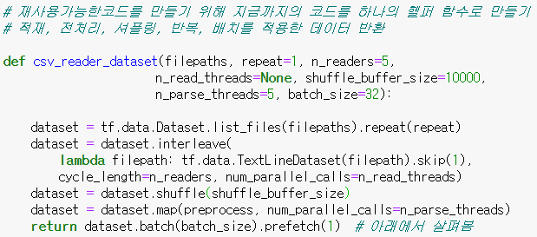
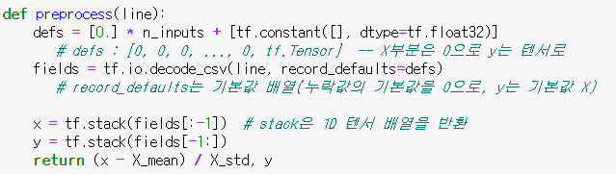
02. Data loading and Preprocessing
Data loading and Preprocessing
list_files() 함수 : 파일 경로를 섞은 데이터 셋 반환
interleave() 함수 : 한 번에 n_readers개의 파일 한 줄씩 번갈아 읽기
num_parallel_calls 옵션 : 병렬화 개수
prefetch(1) : 마지막에 prefetch(1)를 호출하면 데이터셋은 항상 한 배치가 미리 준비되도록!
즉, 한 배치를 훈련하는 동안 다음 배치를 준비함

Slide 12
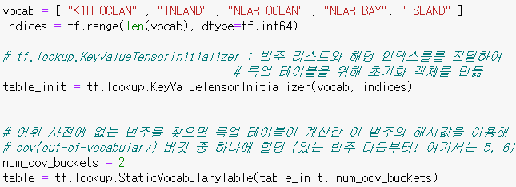
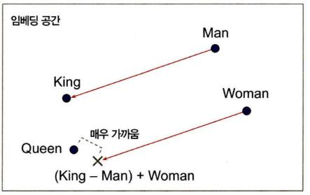
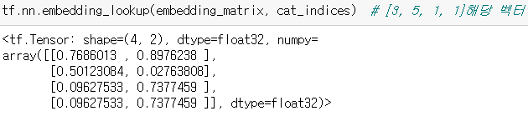
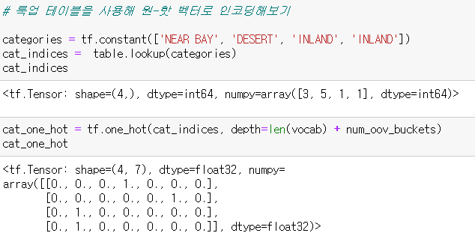
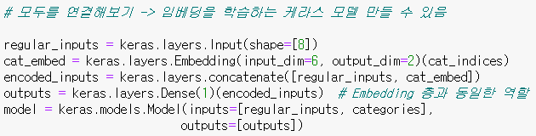
02. Data loading and Preprocessing
Preprocessing categorical feature
One-hot vector
Embedding
: Trainable Dense Vector

Slide 13
Contents
01. Custom model and training
02. Data loading and Preprocessing
03. Deep learning from Scratch

Slide 14
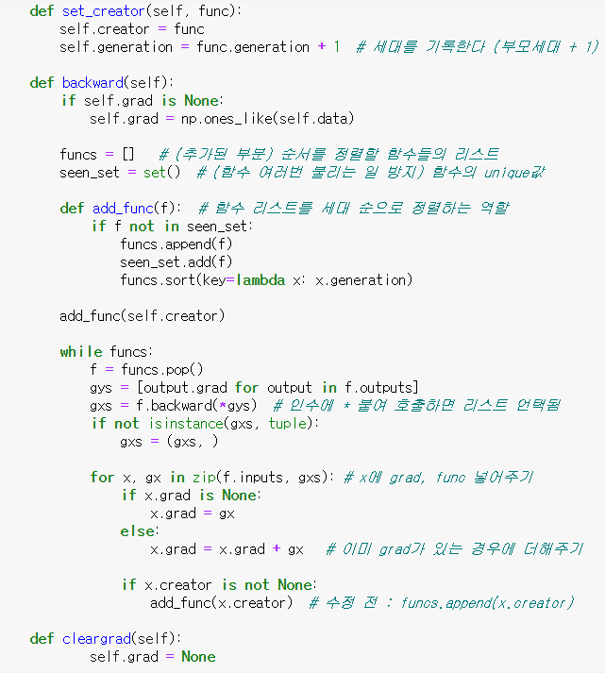
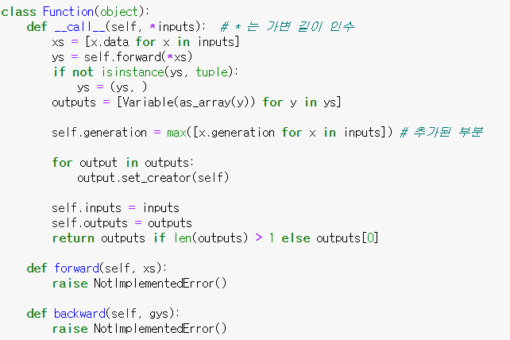
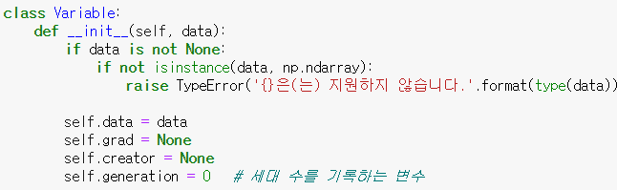
03. Deep learning from Scratch
Review

Slide 15
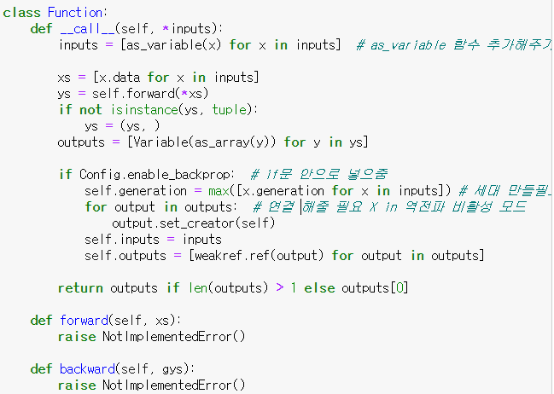
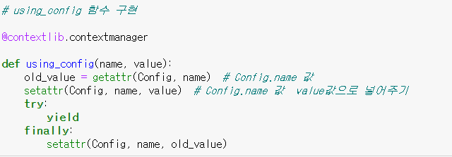
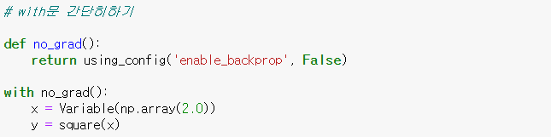
03. Deep learning from Scratch
Modify..

Slide 16
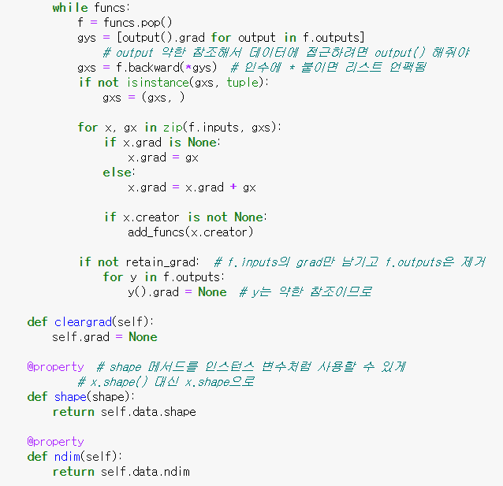
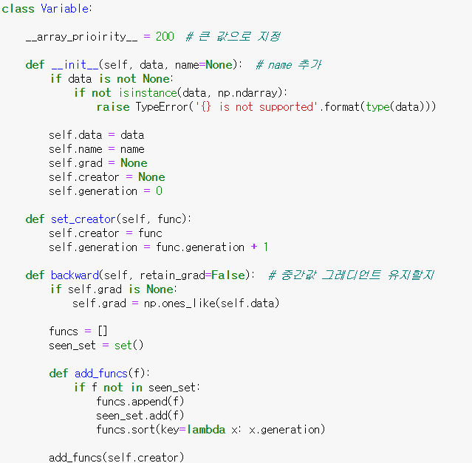
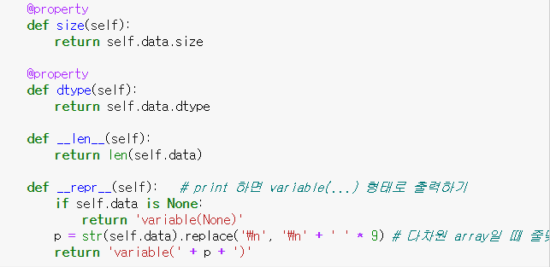
03. Deep learning from Scratch
Modify..

Slide 17
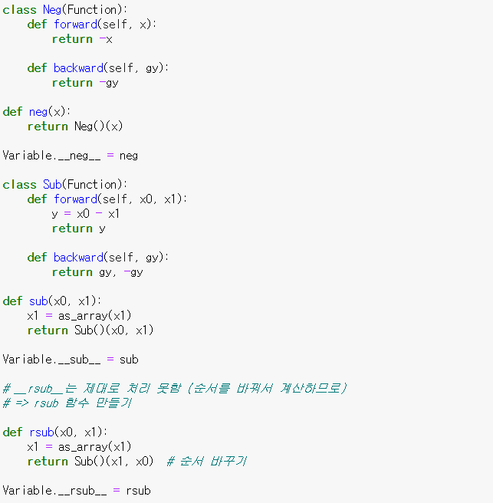
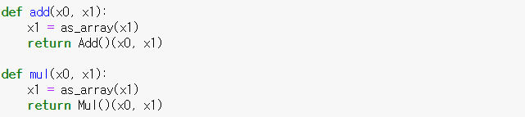
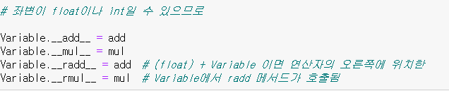
03. Deep learning from Scratch
Modify..

Slide 18
Thank you

